Slide 1
Applied Probability for AI (CMAI 6203 )
Week-6 Lecture
Skewness and Kurtosis in Data Analysis: Why They Matter for AI

Slide 2
Understanding Data Shape Beyond Mean and Variance
Mean and standard deviation describe center and spread but miss critical distribution shape details that can make or break your analysis.
Skewness and kurtosis reveal asymmetry and tail behavior—essential for understanding real-world data patterns that deviate from ideal distributions.
Karl Pearson introduced skewness (1895) and kurtosis (1905) to enrich statistical descriptions beyond simple averages.

Slide 3
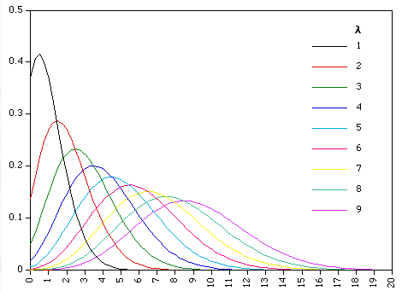
Skewness
Skewness is a statistical measure that quantifies the asymmetry of a probability distribution around its mean. While a normal distribution is perfectly symmetrical (zero skew), a skewed distribution "leans" to one side, resulting in one "tail" being longer or fatter than the other.

Slide 4
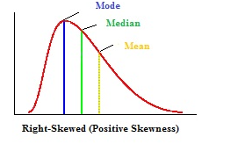
Types of Skewness
Positive Skew (Right-Skewed): The tail extends toward the higher values on the right. Most data points are clustered on the left, but a few extreme high values pull the mean upward, making it greater than the median.
Mean > Median > Mode.
Example: Household income, where most people earn a modest amount, but a few billionaires create a long right tail.

Slide 5
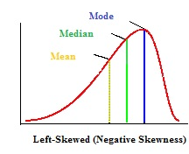
Negative Skew (Left-Skewed):
The tail extends toward the lower values on the left. Most data points cluster on the right, but extreme low values pull the mean downward, making it less than the median.
Mean < Median < Mode.
Example: Age at retirement, where most people retire in their 60s, but a few retire much younger.

Slide 6
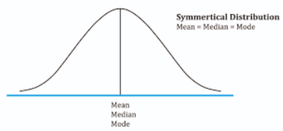
Zero Skewness:
The distribution is perfectly symmetrical, like a bell curve. The mean, median, and mode are all equal and located at the center.
Perfectly balanced distribution like a normal curve.

Slide 7

How to measure skewness
It measures skewness between -1 and +1, where a value of 0 indicates symmetry, positive values indicate positive skew (long tail to the right), and negative values indicate negative skew.

Slide 8
Why It Matters in AI and Data Science
Understanding skewness is vital because many machine learning algorithms (like Linear Regression) assume that data is normally distributed. Heavily skewed data can lead to biased models, slower convergence in gradient-based algorithms, and misleading performance metrics. Practitioners often use transformations like Log, Square Root, or Box-Cox to reduce skewness and bring the data closer to a normal distribution

Slide 9
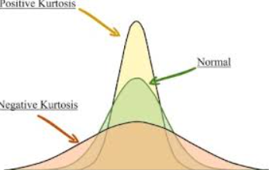
Kurtosis
In the context of AI and machine learning, Kurtosis is a statistical measure that quantifies the "tailedness" of a data distribution, specifically indicating the presence and frequency of outliers
While often mistaken for "peakedness," in AI, kurtosis is used primarily to understand the behavior of extreme values in features and residuals
There are three types of kurtosis, categorized by how their tails and peaks compare to a Normal Distribution

Slide 10
.
1. Mesokurtic (The Baseline)
This is the Normal Distribution.
Shape: A classic bell curve.
Tails: Moderate; outliers are neither extremely rare nor extremely frequent.
AI Context: This is the "gold standard" shape many algorithms assume for features or errors

Slide 11
2. Leptokurtic (Thin & Tall)
The name comes from the Greek lepto, meaning "slender."
Shape: A very sharp, skinny peak with thick, heavy tails.
Excess Kurtosis: Positive (> 0).
AI Context: High leptokurtosis signals a high frequency of outliers. If your data looks like this, your model might be overly sensitive to extreme values, potentially requiring robust scaling

Slide 12
.
3. Platykurtic (Flat & Broad)
The name comes from platy, meaning "broad" or "flat" (like a platypus's bill).
Shape: A low, flat peak with thin, light tails. The data is spread more uniformly.
Excess Kurtosis: Negative (< 0).
AI Context: This indicates a lack of outliers. While "stable," it can sometimes mean the data lacks the "interesting" variance a model needs to learn distinct boundaries between classes

Slide 13

How to measure Coefficient of Kurtosis
Bowley’s Coefficient of Kurtosis, often called the Percentile Coefficient of Kurtosis
Interpretation: A value of roughly 0.263 indicates a Normal (Mesokurtic) distribution.
Tail Behavior: A higher value generally indicates a more peaked distribution with thinner tails (Leptokurtic), while a lower value indicates a flatter distribution with heavier tails (Platykurtic).

Slide 14
Small Case Study: Assessing the Shape of Data
Background
A data analyst in a university wants to study the distribution of final exam scores of students enrolled in a BS Artificial Intelligence course. The aim is to understand whether the scores are symmetrical, skewed, or highly peaked/flat. To do this, the analyst calculates skewness and kurtosis measures.
Collected Data (Summary Statistics)
After analyzing the scores of 120 students, the following statistics were obtained:
Statistic | Value
Mean | 74
Median | 70
Mode | 65
Standard Deviation | 10
Kurtosis | 3.8

Slide 15
Practice Questions
Question 1
The following statistics are given:
Mean = 58
Mode = 52
Standard Deviation = 12
Find the Coefficient of Skewness.
Question 2
Given:
Mean = 72
Median = 68
Standard Deviation = 10
Calculate the Coefficient of Skewness.
Use:
Sk=(Mean−Mode)/Standard Deviation

Slide 16
Practice Questions
The quartiles of a distribution are:
Q1=20
Q2=25
Q3=32
Calculate Bowley’s coefficient of skewness.and comment on the shape of the distribution

Slide 17
Practice Questions
Question:
Marks of students in a statistics test are given below:
Tasks:
Find Mean
Find Mode
Calculate Karl Pearson’s Coefficient of Skewness
Calculate coefficient of Kurtosis
Marks | Frequency
10–20 | 4
20–30 | 6
30–40 | 10
40–50 | 8
50–60 | 2

Slide 18
Step 1: Assessing Skewness
Since:
Mean > Median > Mode
This pattern indicates a positively skewed distribution (right-skewed). It means:
Most students scored around the average
A few students achieved very high scores
The right tail of the distribution is longer

Slide 19
Step 2: Assessing Kurtosis
The kurtosis value is 3.8.
Interpretation:
Kurtosis = 3 → Normal (Mesokurtic)
Kurtosis > 3 → Leptokurtic (more peaked)
Kurtosis < 3 → Platykurtic (flatter)
Since 3.8 > 3, the distribution is Leptokurtic.

Slide 20
Conclusion
The distribution of exam scores is:
Positively skewed
Leptokurtic
This suggests that most students performed around the average, while a few students achieved exceptionally high scores, making the distribution slightly right-tailed and more peaked than normal.

Slide 21
Practice Questions
Question:
For a frequency distribution, the following values are calculated:
P90=110
P10=30
Q3=80
Q1=50
Calculate the Coefficient of Kurtosis and explain the shape of the distribution.

Slide 22
Practice Questions
Question:
A dataset has:
P90=70
P10=20
Q3=55
Q1=35
Tasks:
Calculate Coefficient of Kurtosis
Compare it with the normal distribution value
State whether the distribution is peaked or flat

Slide 23
Why Skewness and Kurtosis Matter in AI Model Training
Assumption Violations
Feature Importance Distortion
Many AI algorithms assume normally distributed features. Skewed or heavy-tailed data can bias predictions and violate fundamental model assumptions.
Skewness can artificially amplify or suppress feature importance, misleading the model about which variables truly matter for accurate predictions.
Outlier Sensitivity
Convergence Issues
High kurtosis signals extreme outliers that can destabilize training algorithms, cause overfitting, or trigger numerical instability during optimization.
Gradient-based optimization struggles with highly skewed data, leading to slow convergence or failure to find optimal model parameters.

Slide 24




Handling Skewness and Kurtosis in AI Pipelines
Detect
Transform
Apply log, square root, or Box-Cox transformations to normalize skewed features.
Compute metrics and visualize with histograms during EDA to identify distribution issues.
Stabilize
Optimize
Use robust scaling, winsorization, or outlier trimming to manage kurtosis effects.
Achieve faster convergence, better interpretability, and superior predictive power.

Slide 25

Conclusion: Mastering Data Shape is Key to AI Success
Deeper Insights
Avoid Costly Mistakes
Skewness and kurtosis unlock understanding of data beyond simple averages and spreads.
Ignoring distribution shape risks fundamentally flawed models and missed opportunities.
Build Better AI
Embrace these metrics to create robust, fair, and accurate machine learning systems.

